Slide 1
Unit-3
Cont…

Slide 2
Functional dependency
A functional dependency is a constraint that specifies the relationship between two sets of attributes where one set can accurately determine the value of other sets.
A functional dependency is denoted by an arrow “→”. The functional dependency X → Y, where X is a set of attributes that is capable of determining the value of Y.
The attribute set on the left side of the arrow, X is called Determinant, while on the right side, Y is called the Dependent.
Functional dependencies are used to mathematically express relations among database entities and are very important to understand advanced concepts in Relational Database System

Slide 3
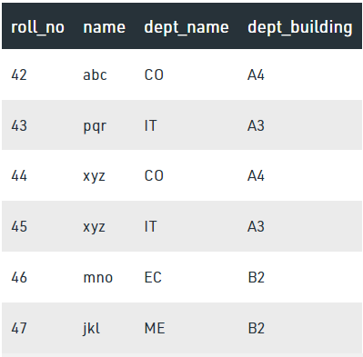
From the table we can conclude some valid functional dependencies: roll_no → { name, dept_name, dept_building }, Here, roll_no can determine values of fields name, dept_name and dept_building, roll_no → dept_name , Since, roll_no can determine whole set of {name, dept_name, dept_building}, it can determine its subset dept_name also. dept_name → dept_building , Dept_name can identify the dept_building accurately, since departments with different dept_name will also have a different dept_building More valid functional dependencies: roll_no → name, {roll_no, name} ⇢ {dept_name, dept_building}, etc.

Slide 4
Armstrong’s axioms/properties of functional dependencies:
Reflexivity: If Y is a subset of X, then X→Y holds by reflexivity rule
For example, {roll_no, name} → name is valid.
Augmentation: If X → Y is a valid dependency, then XZ → YZ is also valid by the augmentation rule.
For example, If {roll_no, name} → dept_building is valid, hence {roll_no, name, dept_name} → {dept_building, dept_name} is also valid.→
Transitivity: If X → Y and Y → Z are both valid dependencies, then X→Z is also valid by the Transitivity rule.
For example, roll_no → dept_name & dept_name → dept_building, then roll_no → dept_building is also valid.

Slide 5
Types of Functional dependencies
Trivial functional dependency
Non-Trivial functional dependency
Multivalued functional dependency
Transitive functional dependency

Slide 6
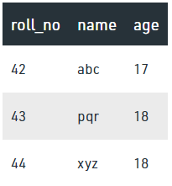
1. Trivial Functional Dependency
In Trivial Functional Dependency, a dependent is always a subset of the determinant.
i.e. If X → Y and Y is the subset of X, then it is called trivial functional dependency
Here, {roll_no, name} → name is a trivial functional dependency, since the dependent name is a subset of determinant set {roll_no, name}
Similarly, roll_no → roll_no is also an example of trivial functional dependency.

Slide 7
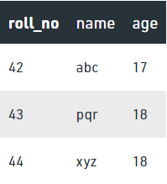
2. Non-trivial Functional Dependency
In Non-trivial functional dependency, the dependent is strictly not a subset of the determinant.
i.e. If X → Y and Y is not a subset of X, then it is called Non-trivial functional dependency.
Here, roll_no → name is a non-trivial functional dependency, since the dependent name is not a subset of determinant roll_no
Similarly, {roll_no, name} → age is also a non-trivial functional dependency, since age is not a subset of {roll_no, name}

Slide 8
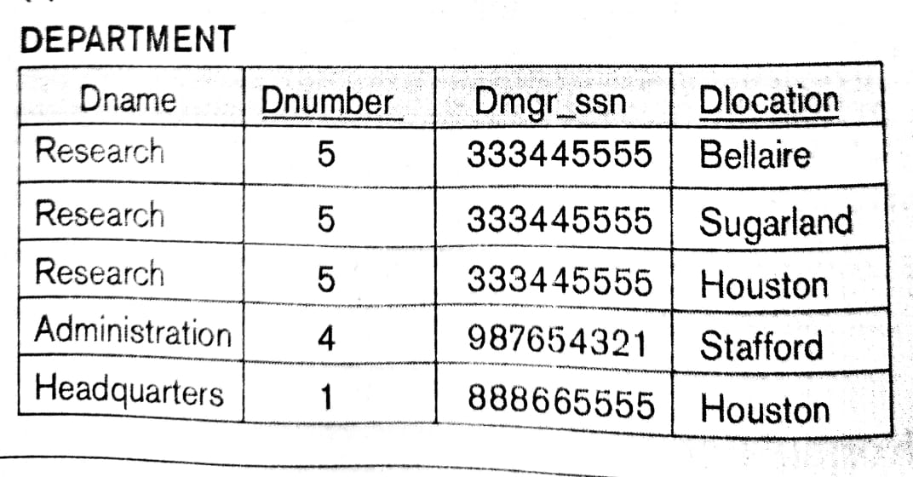

Slide 9
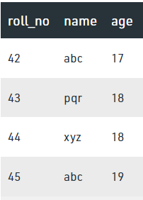
3. Multivalued Functional Dependency
In Multivalued functional dependency, entities of the dependent set are not dependent on each other.
i.e. If a → {b, c} and there exists no functional dependency between b and c, then it is called a multivalued functional dependency.
Ex.
Here, roll_no → {name, age} is a multivalued functional dependency, since the dependents name & age are not dependent on each other(i.e. name → age or age → name doesn’t exist !)

Slide 10
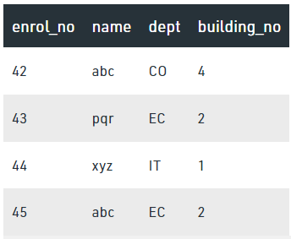
4. Transitive Functional Dependency
In transitive functional dependency, dependent is indirectly dependent on determinant.
i.e. If a → b & b → c, then according to axiom of transitivity, a → c. This is a transitive functional dependency
Here, enrol_no → dept and dept → building_no,
Hence, according to the axiom of transitivity,
enrol_no → building_no is a valid functional dependency.
This is an indirect functional dependency, hence called Transitive functional dependency.

Slide 11
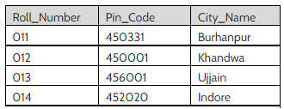
Transitive FD example
From above table,
Roll_Number --> Pin_Code and Pin_Code --> City_Name hold.
Than Roll_Number --> City_Name is a transitive FD.

Slide 12
Normalization
First Normal Form: This rule defines that all the attributes in a relation must have atomic domains. The values in an atomic domain are indivisible units.
Eg.
Convert into 1st NF as:
{Car_Model, Color} and {Car_Model, Price}
Car_model | Color | Price
1 | Red, Grey, Black | 5lk , 6lk , 4.5lk
2 | Red, Yellow, White | 5.5 lk , 4lk, 6lk
3 | Black, White | 7lk , 6lk
4 | White, Grey | 6lk , 7lk

Slide 13
Cont…
Second Normal Form:
Every non-prime attribute should be fully functionally dependent on prime key attribute.
That is, if X → A holds, then there should not be any proper subset Y of X, for which Y → A also holds true.
Eg.
Stud_Proj: {stud_id, name, proj_id, proj_name}
Student: {stud_Id, name, proj_Id,}
Project: {proj_id, proj_name}

Slide 14
Cont…
Third Normal Form:
For a relation to be in Third Normal Form, it must be in Second Normal form and the following must satisfy
No non-prime attribute is transitively dependent on prime key attribute.
For any non-trivial functional dependency,
X → A, then either
X is a superkey or
A is prime attribute.

Slide 15
Practical
Set Operation: Clause
UNION,
UNION ALL,
INTERSECTION,
MINUS

Slide 16
Union
Multiple queries can be put together using UNION clause
For using UNION clause no. of columns and it’s datatype must be same
The IN operator has a higher precedence than the UNION operator
NULL Values are not ignored during duplicate checking
Eg.
select a_id, city from applicant where city like 'Baroda'
union
select e.et_id, d.city from entrance_test e, etest_details
where e.et_id = d.et_id and d.city like'Baroda'

Slide 17
Intersect
Displays only common rows as output from multiple table’s intersection
Intersect does not ignore NULL values
Eg.
Suppose need to display Enroll_No and Name of students who are the 1st year and 2nd year rankers.
Rankers are stored in separate tables of 1st year and 2nd Year
So can use Intersect clause as:
Select Enroll_No, Name from FYRank
INTERSECT
Select Enroll_No, Name from SYRank

Slide 18
Minus
The output of Minus clause are the rows from the output of 1st query after filtering the rows received by the second query
Eg.
Display students who are ranker I 1st year but not in 2nd year
Select Enroll_No, Name from FYRank
MINUS
Select Enroll_No, Name from SYRank

